Slide 1
Rapid Synchronization Recovery from Single Event Effects in the Large Hadron Collider
Anatoliy Martynyuk – 3rd of June, 2022

Slide 2
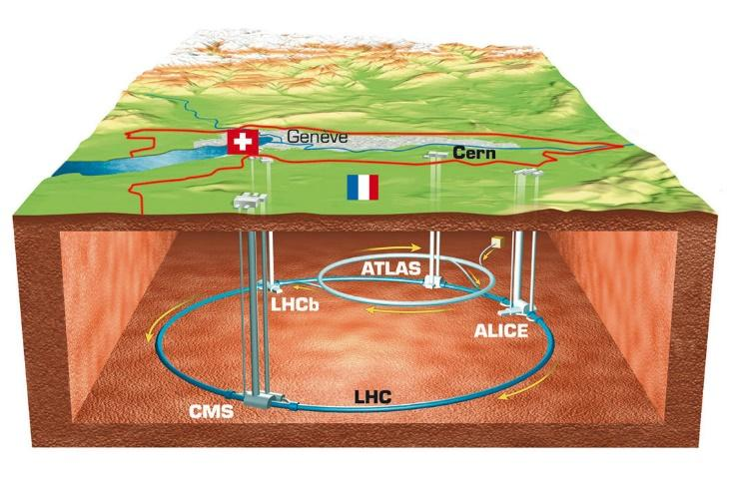
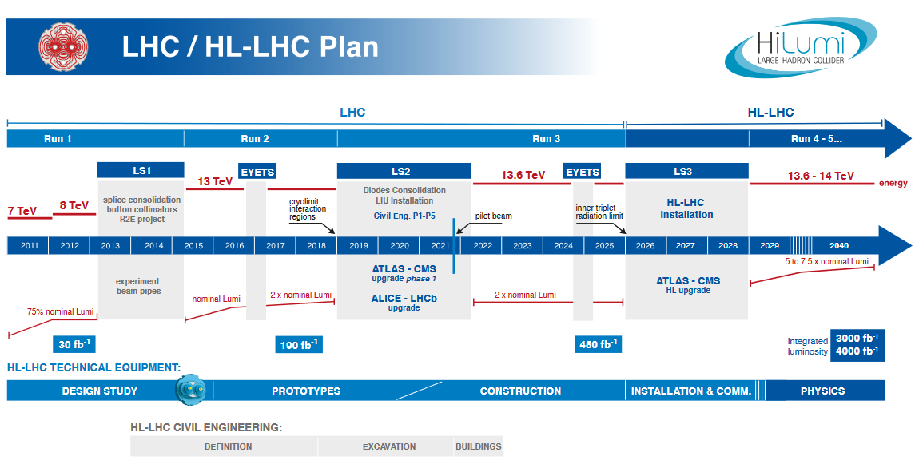
The Large Hadron Collider
The largest particle accelerator in the word.
Speeds subatomic particles up to near light speed, collides them and record results.
Anticipating a significant upgrade in luminosity through 2029.

Slide 3
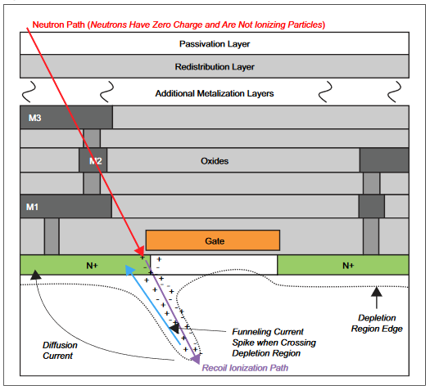
Single Event Effects: Physics
Consequence of subatomic particles creating charged paths resulting in current/voltage spikes.
Single Event Upset (SEU): Event occurred in memory and flipped a bit.
Single Event Transient (SET): Event occurred on a wire and triggered a glitch.

Slide 4
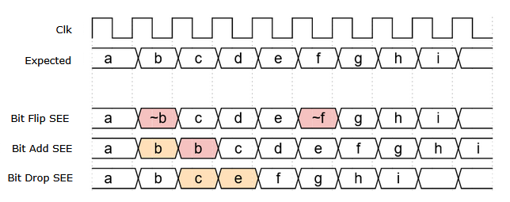
Single Event Effects: Digital Abstraction
We can ignore how an SEE occurs or where and deal with the product of it occurring.
Bit flips are a result of memory upsets, and glitches being sampled.
Adds and drops are a result of glitches and frequency drift in the clock or in clock generating logic.

Slide 5
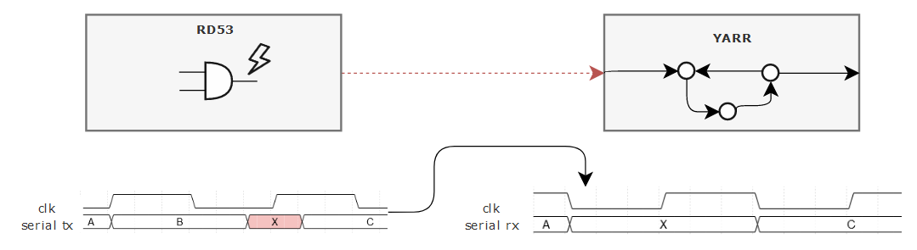
Single Event Effects: At the LHC
RD53 Pixel Readout Chip is at collision site and experience high radiation.
YARR DAQ is far from radiation site and experiences *no* radiation.
YARR has to deal with SEE effects passed to it by the RD53.

Slide 6
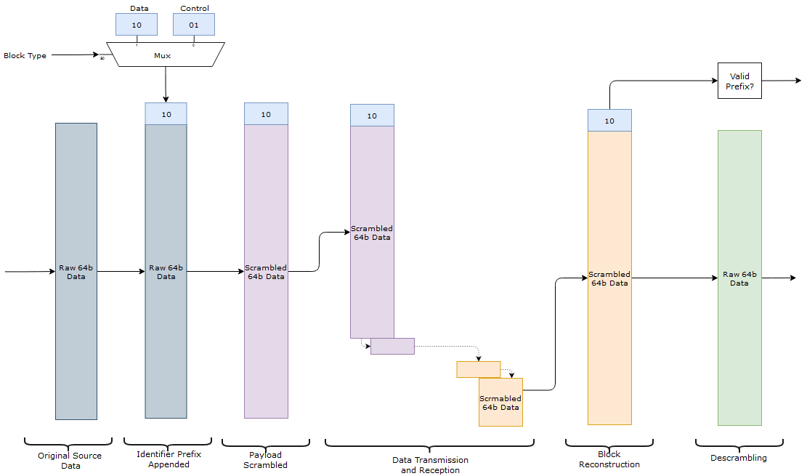
64b/66b Encoding
Communication is done over a single differential data wire.
Encoding transforms 64b payload into a 66b block.
Features:
Stream alignment.
Guaranteed transition.
Statistical DC Balancing.

Slide 7
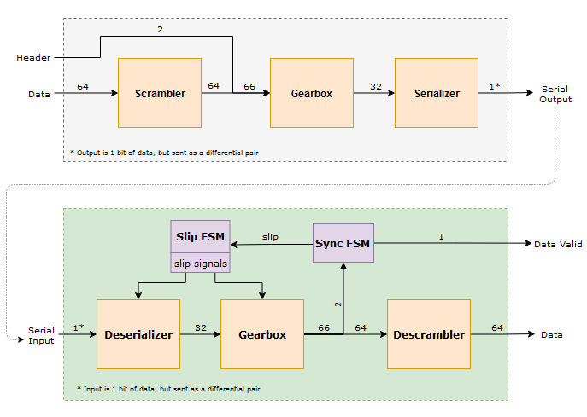
Communication Tx/Rx
Each block in the Tx has a reverse counterpart in the Rx.
The scrambler responsible for data formatting features.
Gearbox performs 64 to 66 translation.

Slide 8
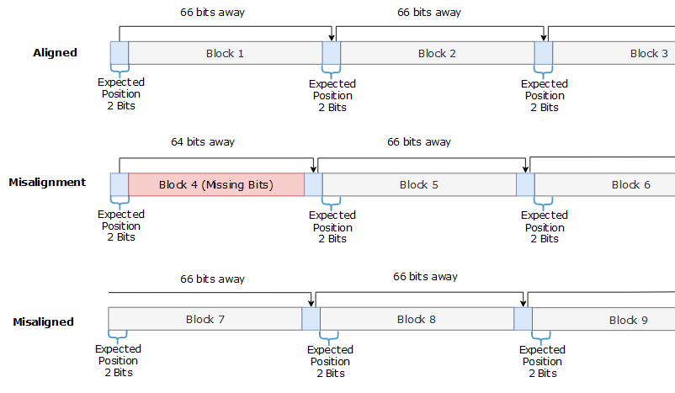
Alignment Abstract
Alignment based around stream periodicity.
YARR expects a 01 or 10 every 66 bits received.
Once misaligned, stream needs to be shifted to move header back into expected position.

Slide 9
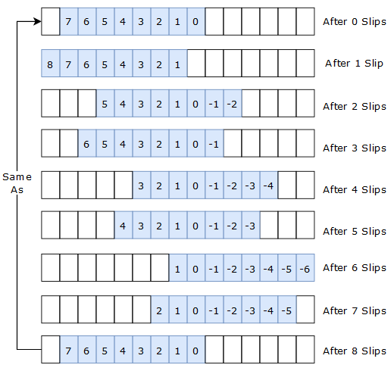
Original Scheme: Serializer Bitslip
Serializer operates in DDR mode to keep up with 1.28 Gbps data rate.
DDR serializer utilizes bit slip module to drop and add bits.
Abstractly described as a 15-bit buffer with a selection window that snaps back after 8 “slips”.

Slide 10
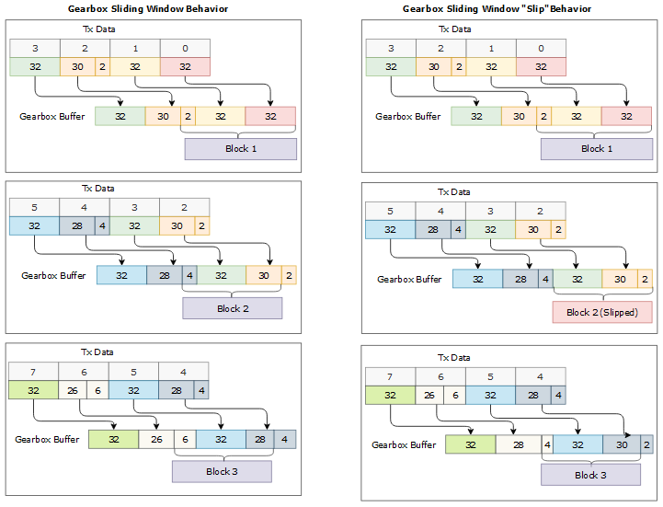
Original Scheme: Gearbox Bitslip
Gearbox operating behavior shifts in two 32-bit blocks and shifts out one 66-bit block.
Input-output mismatch results in 2 bits more being read out than in.
Sliding window shifts over 2 bits each shift out to accommodate mismatch.
Gearbox “slip” freezes the sliding window.

Slide 11
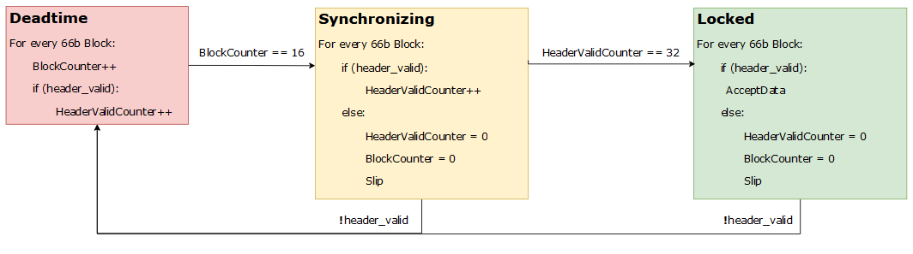
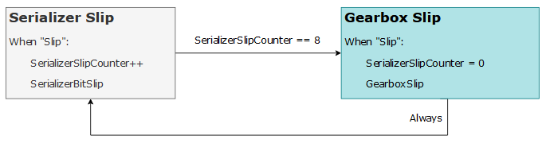
Original Scheme: Control FSM
Deadtime state ensures the stream has time to “settle” after a slip.
Synchronizing State counts a minimum of 16 consecutive valid words before system locks on.
Any single invalid header desynchronizes and moves FSM to Deadtime.
8 serializers bit slips for every gearbox bit slip.

Slide 12
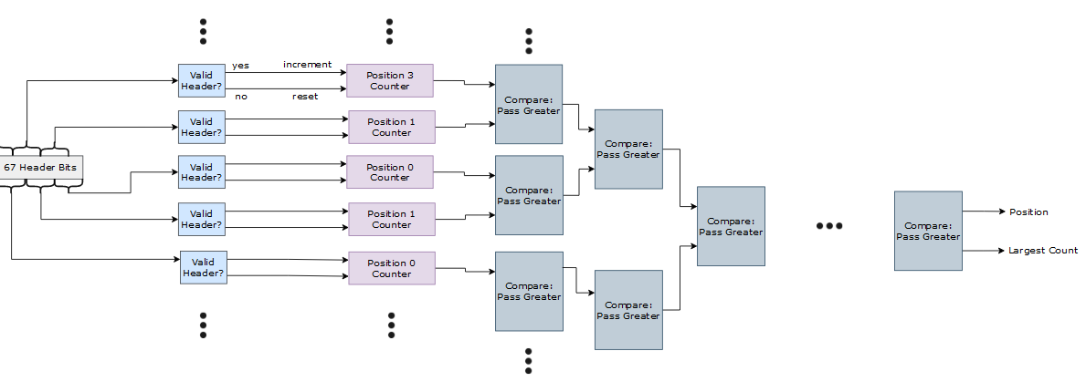
Full Parallel (FP) Scheme
Utilize parallelization to monitor multiple possible positions simultaneously.
Combinatorial logic requires pipelining to meet timing.
Combinatorial logic demands significant resources.

Slide 13
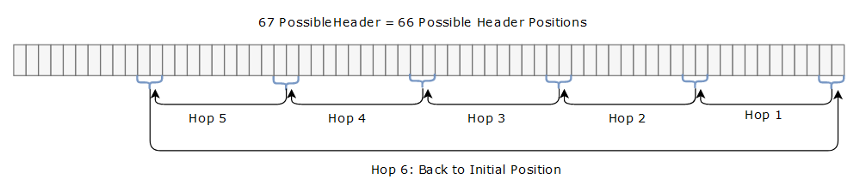
Header Seeker (HSX) Scheme
Utilize less parallelism to reduce resources and pipelining costs. Retain logical components of the FP.
Assign a multiple to a seeker/monitor to rotate through.
Hop performed whenever an invalid header is seen. No deadtime, fail fast.

Slide 14
Results: Original and Proposed Performance
Simulated shifting stream bits by n, with n swept from 1 to 65.
Each shift misalignment and recovery repeated 25 times, average taken.
Comparison between original system and all proposed variants.

Slide 15
Results: Original and Proposed Utilization
Targeted a Kintex 7 T160 Xilinix FPGA, using Vivado Mapping tools.
Utilization is of an entire single channel, not just the aligner.
YARR may have 4 channels on a single device.

Slide 16
Results: Proposed Variants Performance
Variants all approximate a flat line across all misalignment shifts.
16 of the blocks lost are a result of requiring 16 consecutive valids blocks to be synchronized.

Slide 17
Results: Proposed Variants Tradeoffs
Summary of LUT resource utilization vs unweighted average of blocks lost by variant.
Use to determine best fit scheme for application performance and constraints specs.

Slide 18

Future Work
SYNC_MAX is a major component in both the original system and HSX variants. Improving this value improves relative performance of every system.
Parametrizable system with all HSX and FP aligners folded into it would be a great step in protability and configurability.
Aligners developed as well as original bias towards bit adds and drops and don’t address bit flips well. An improvement on current schemes or implementation of a new one to address flips may be valuiable.

Slide 19
Questions?

